Slide 1
Question 1
Bongani Mthembu | 27/02/2026

Slide 2
Methodology
Approach:
Data Preparation: Cleaning and handling imbalanced data.
Feature Engineering: Domain-specific and statistical analysis (Weight of Evidence and Information value).
Model Selection: Evaluated Logistic Regression, Random Forest, and XGBoost (final choice).
Evaluation Metrics: AUC, Gini Coefficient, and KS Statistic.

Slide 3
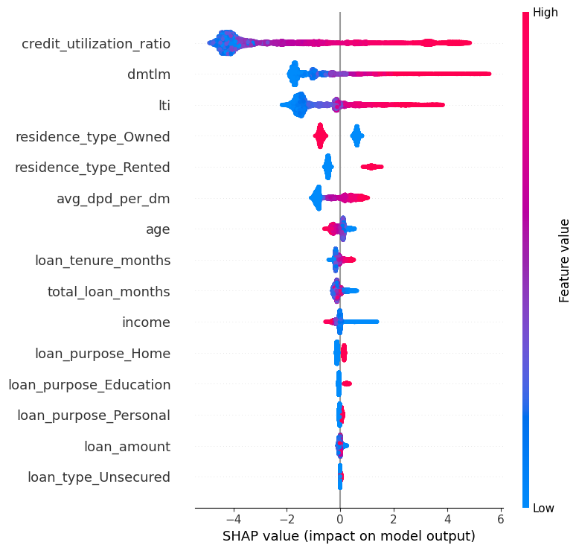
Key Findings and Insights
Insights:
Top predictors: Credit Utilization Ratio, Loan to Income Ratio, and Delinquency Months to Loan Months Ratio.

Slide 4
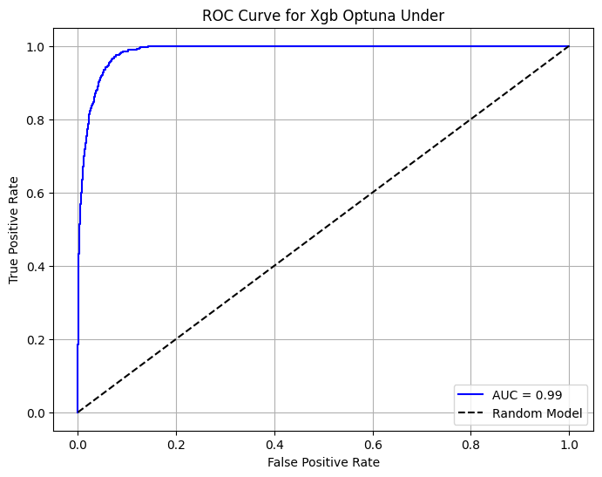
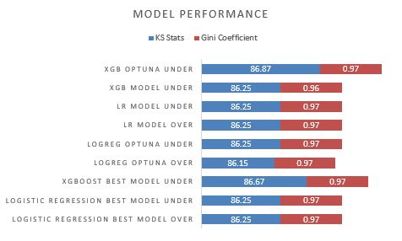
Key Findings and Insights (Cont.)
Insights:
Achieved exceptional performance with XGBoost Model Under-sampling method using Optuna for parameter tuning (AUC: 0.99, Gini: 0.97, KS: 86.87).
Decile analysis confirmed effective separation of high-risk borrowers.

Slide 5
Recommendations and Next Steps
Actionable Suggestions:
Integrate the model into the loan approval workflow.
Use insights to refine credit policies and risk mitigation strategies.
Future Steps:
Retrain the model periodically to address data drift.
Explore additional features like macroeconomic indicators.

Slide 6
Conclusion
Summary:
Developed a robust, interpretable credit risk model with high predictive accuracy.
Provides actionable insights for improving decision-making and managing defaults.
Call to Action:
Ready for deployment and integration into business processes.

Slide 7
Q&A
Questions & Discussion
We welcome your feedback and queries!

